Slide 1
StartUp Growth
EIT Digital Master School @Eötvös Lorand University
Business Development Lab
Inspired by “Grow fast or die slow” a paper by E. Kutcher, O. Nottebohm, and K. Sprague

Slide 2
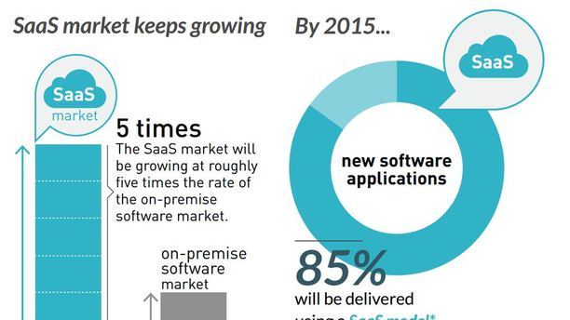
The engine of growth
Software and online services industry’s booms
=> Growth is essential

Slide 3
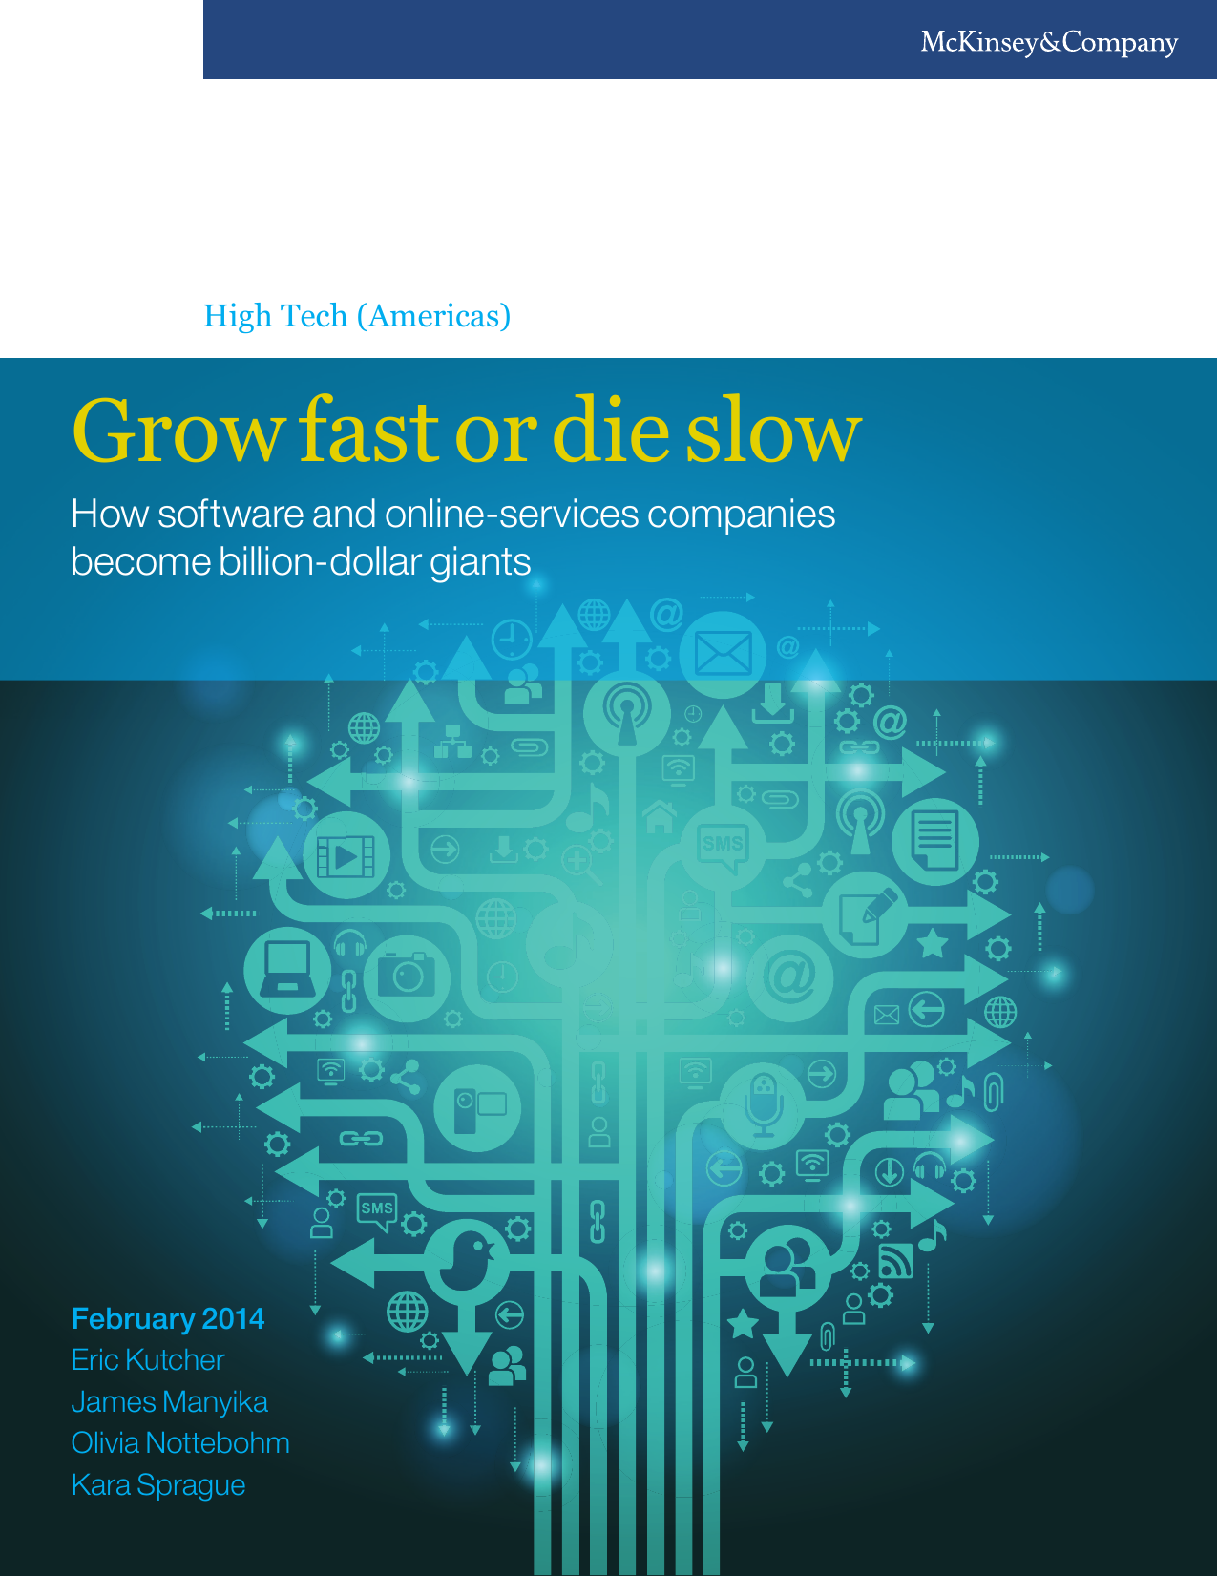
Grow Fast or Die Slow
https://studylib.net/doc/8899110/grow-fast-or-die-slow
2014 paper research, on:
3,000 software and online-services companies between 1980 and 2012.
70 companies executives surveyed
3

Slide 4

Three main findings:
Growth trumps all.
Sustaining growth is really hard.
There is a recipe for sustained growth.
4

Slide 5
1- Growth trumps all
“It is growth that matters most in the early stages of a company’s life” - “Grow fast or die slow” a paper by E. Kutcher, O. Nottebohm, and K. Sprague
Growth is judged based on the industrial sector:
Health-care company grows 20% annually
=> happy investors!
SW company grows 20%
=> 92 % chance of failing in few years!
5

Slide 6
1- Growth trumps all: back to the study
2 Revenue thresholds: $100 million or $1 billion
3 Segment boundaries :
- supergrowers
- growers
- stallers
based on % of 2-year compound annual growth rate (CAGR)
6

Slide 7
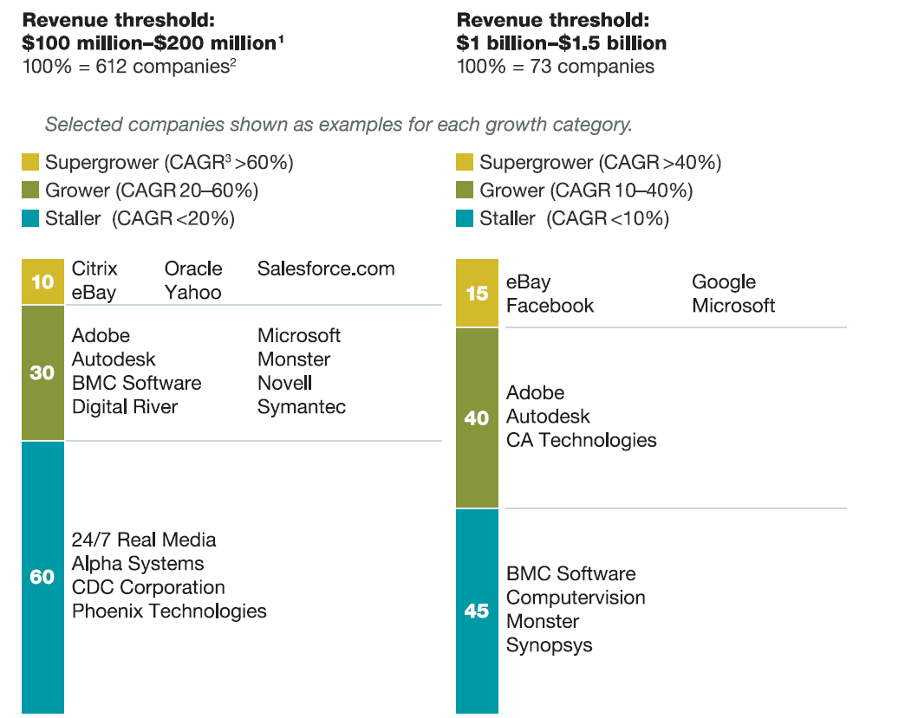

Slide 8
1- Growth trumps all: Why?
“Growth yields greater returns”
first threshold supergrowers generated 5 times more returns than growers
second threshold supergrowers produced 10 times more .
stallers with growth rates below 20% produced negative returns
8

Slide 9
1- Growth trumps all: Why?
“Growth predicts long-term success”
higher growth rates => sustained success.
supergrowers were 8 times more likely than stallers to grow
3 times more likely to do so than growers
9

Slide 10
1- Growth trumps all: Why?
“Growth matters more than margin or cost structure”
little or no correlation between growth and cost structure
True until companies reach $4 billion in revenues
After margins are really important!
10

Slide 11
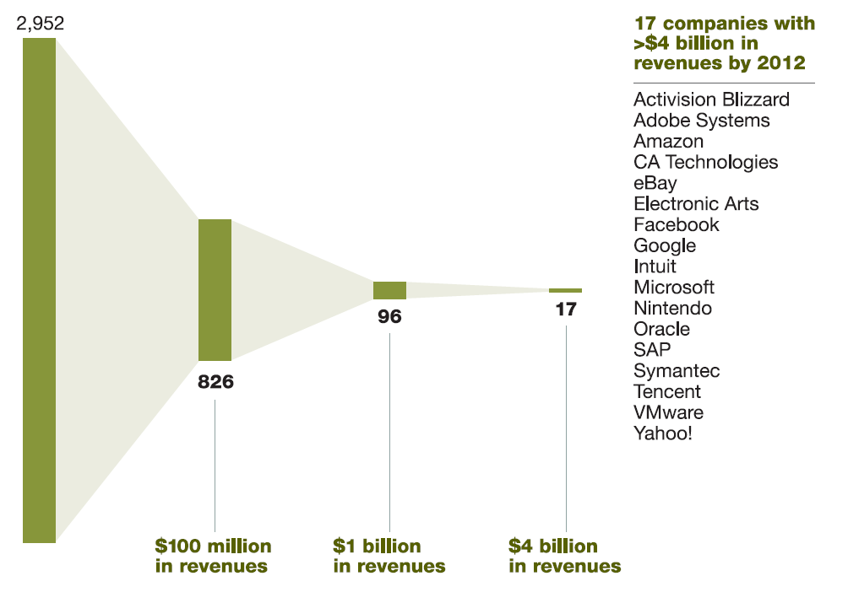
2- Sustaining growth is really hard
Small probability of making it big!
28%
3%
0.6%
11

Slide 12
2- Sustaining growth is really hard
Success is fleeting:
85 % of supergrowers unable to maintain their growth rates
Only ¼ were able to get back on track
Still with capitalizations 53% lower than steady supergrowers.
12

Slide 13
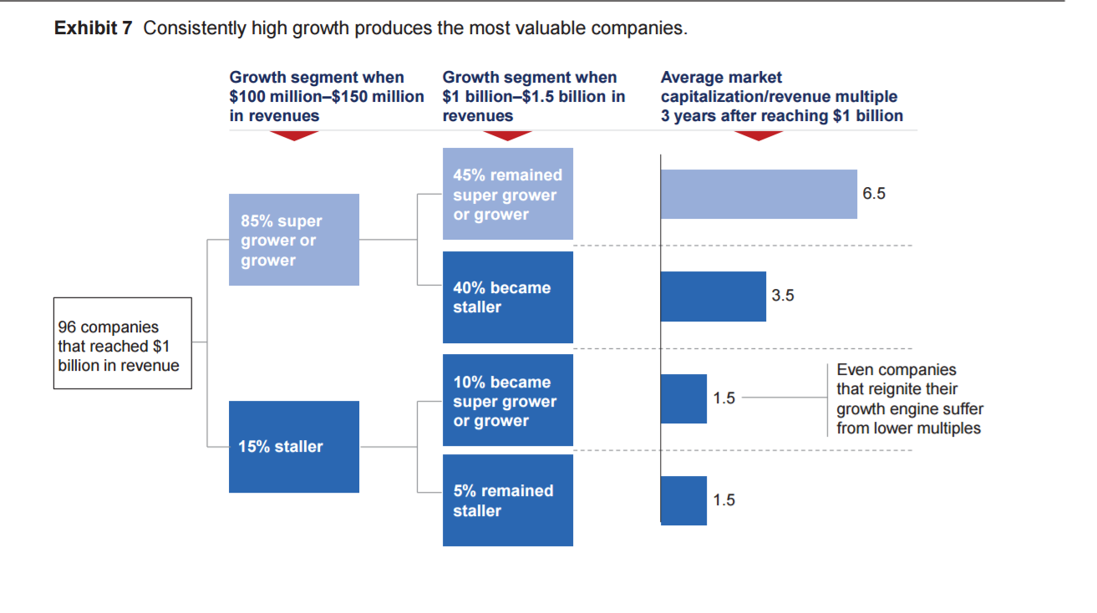
2- Sustaining growth is really hard
13

Slide 14
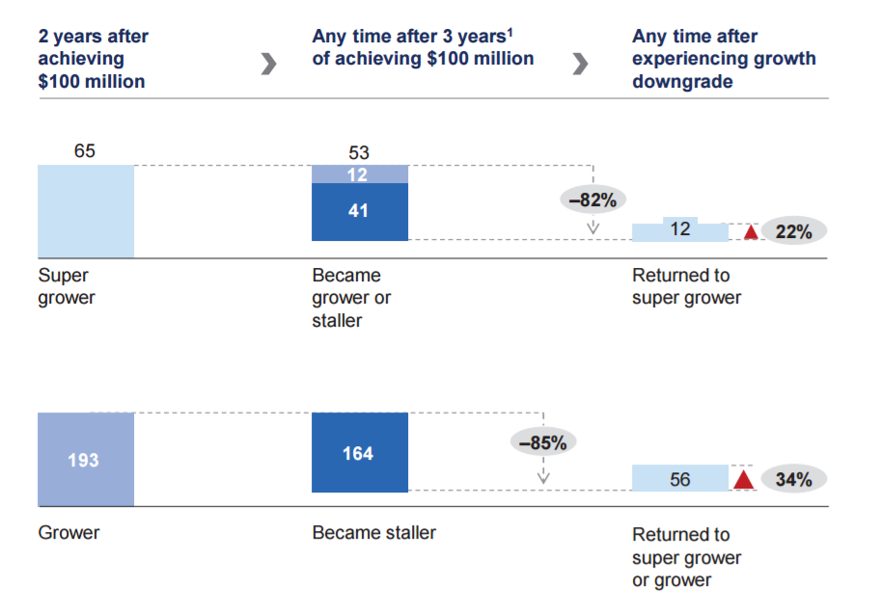
14

Slide 15

3- A recipe for sustained growth
“Growth happens in phases”
Prelude Act One Act Two
15

Slide 16
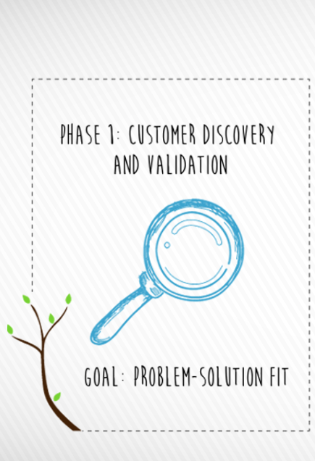
3- A recipe for sustained growth: Prelude
test CPS fit
typically through one-off solutions for initial customers (MVP)
is all about finding a business model that appeal
to a broad customer set.
16

Slide 17

3- A recipe for sustained growth: Act One
narrow to an offer that truly scales
serving many customers and consistently delivering revenues.
ride to 100 of millions and may turn to IPO
capital infusion help expands
at some point it will no longer be sufficient
(=> need for act two)
17

Slide 18

3- A recipe for sustained growth: Act One
5 critical enablers of growth in act one:
Right market
Good revenue model
Rapid adoption focus
Stealth
Incentives to leadership team
18

Slide 19

3- A recipe for sustained growth: Act One
Right market : ideally a “limitless” market with millions of end points
Good revenue model: enables the company to capture demand and to scale up
Rapid adoption focus: do not became lost in the pursuit of the first adopter customer, design product for mass use
19

Slide 20
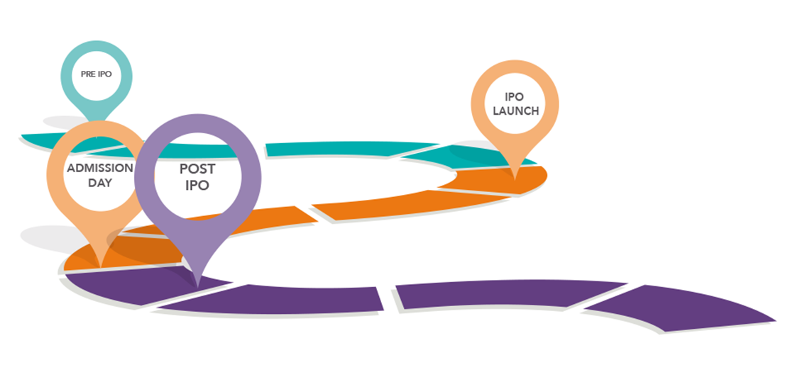
3- A recipe for sustained growth: Act One
Stealth:
maintaining a low profile with
alpha and beta products
as a barrier to entry.
5. Incentives to leadership team:
Think of life beyond the IPO.
Make them focus on building
$1 billion companies in
revenue.
20

Slide 21
3- A recipe for sustained growth: Act Two
in the span between $100 million and $1 billion
the company reach natural market-size or market-share limits
The enablers of growth must change!
21

Slide 22
3- A recipe for sustained growth: Act Two
Three viable growth strategies:
new geographies or channels
new adjacent product markets
Transforming the product into a platform
22

Slide 23
3- A recipe for sustained growth: Act Two
New geographies or channels:
Only if the original target market is fast growing and still viable!
as Facebook did, focusing on Anglophone markets
23

Slide 24
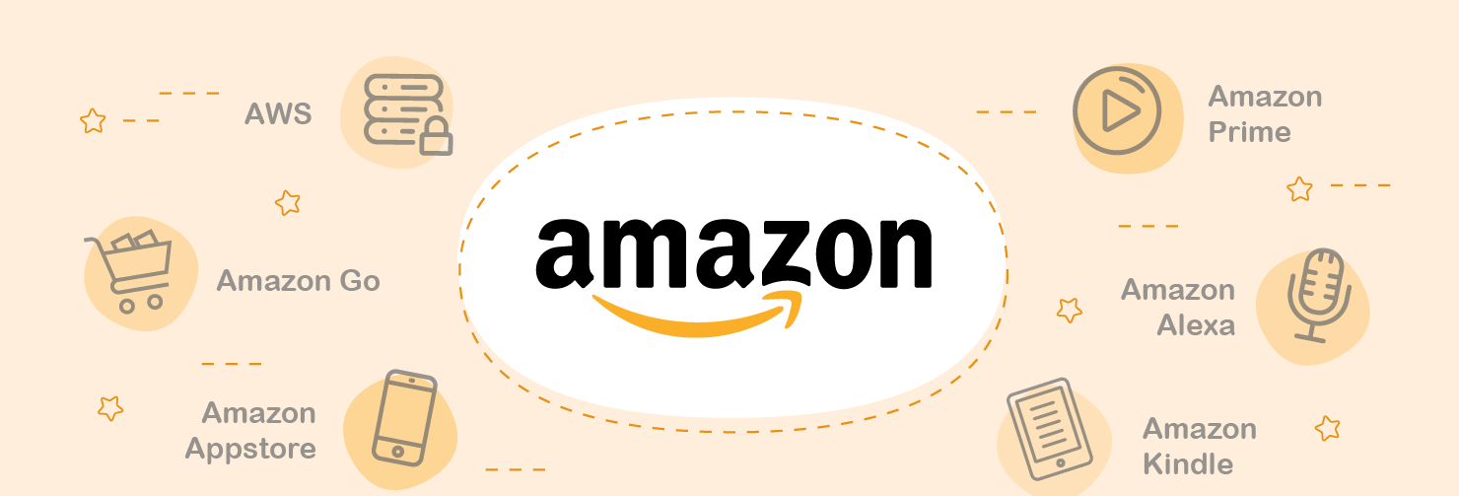
3- A recipe for sustained growth: Act Two
new categories (expanding a e-commerce engine to new retail categories)
24

Slide 25

3- A recipe for sustained growth: Act Two
new outlets (as Google did with Gmail),
25

Slide 26

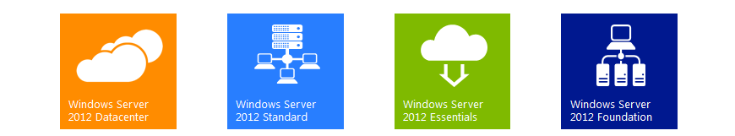
3- A recipe for sustained growth: Act Two
New adjacent product markets:
Microsoft replicated its success in desktop OS
moving into server OS
and eventually enterprise applications
26

Slide 27

3- A recipe for sustained growth: Act Two
Transforming the product into a platform:
an “ecosystem” of complementary products and services
ex. Microsoft Office, built on top of Microsoft Windows.
27

Slide 28
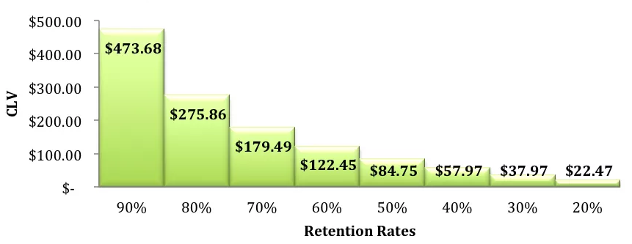
3- A recipe for sustained growth: Act Two
Indicators of a coming stall (need to start act two):
slowing acquisition of customers (market saturation)
declining lifetime value customers,
28

Slide 29
3- A recipe for sustained growth: Act Two
Indicators of a coming stall (need to start act two):
decreasing participation of partners (developers or channel resellers)
market disruption from new entrants
loss of key talent from sales, presales, or engineering.
29

Slide 30

3- A recipe for sustained growth: Act Two
Common pitfalls:
select the wrong market or product offering
insufficient diligence in assessing the new market
not having the right capabilities in-house to design and build that next offering
underinvest in the resources or budget required to make the act-two offering
30

Slide 31
3- A recipe for sustained growth: ask yourself
How much growth do we need, and how quickly do we need it?
How much growth is left in our core markets?
How secure are we in our core markets?
31

Slide 32
3- A recipe for sustained growth: ask yourself
What opportunities to expand our current businesses?
And what opportunities to generate more cash to invest in growth?
What new opportunities do we see for a great next act, when do we move?
32

Slide 33
Beware of your eagerness to grow!
"Companies that grow fast are often foregoing fundamentals — profit, processes, protocols, etc. — which leaves them open to competition. A company that built [its] foundation with strategic thought will be less vulnerable as it accelerates growth."
- Numaan Akram, founder and CEO of Rally Bus, a crowdsourced event transportation company.
33

Slide 34
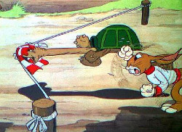
Maintain slow but steady business growth
1 - Take your time, but be ready to move quickly when necessary.
slow down and refine your product
recognize which opportunities can help you grow
be ready to move in and seize it
34

Slide 35
Maintain slow but steady business growth
2 - Invest in the right people when you need them
a way to ensure steady growth is to invest in people
is a double-edged sword: you'll also have a much larger payroll!
AKA finding the right people at the right time
35

Slide 36

Maintain slow but steady business growth
3 - Keep an eye on your cash flow
Managing your company in a way that maximizes cash flow will put you on the path to success.
36

Slide 37

Maintain slow but steady business growth
4 - Plan for the future, rather than just acting on current trends.
with a clear destination in mind, you can build a winning strategy.
37

Slide 38

Maintain slow but steady business growth
ex. when e-signature was invented no finance or bank jumped on it,
Startup envisioned success, because that's where there are a lot of paper-heavy transactions.
38

Slide 39
Thank you!
Brought to you by EIT Digital Master School @Eötvös Lorand University
Find me at: anna.reale@inf.elte.hu

